Slide 1
Applying DevOps Practices to Architect Your Delivery Pipeline for Speed
Carmen DeArdo

Slide 2
Speaker
Carmen DeArdo
Senior VSM Strategist @ Tasktop Technologies,
Carmen has experience both leading and consulting on Enterprise wide DevOps Journeys over the last decade. His current focus is on utilizing this experience and Value Stream Management principles to help companies accelerate their flow of business value work. @carmendeardo

Slide 3


The Problem
We have implemented Agile!
We have implemented New Technologies!
We have certified Processes!
So why is the Business Still Unhappy?

Slide 4
Increase Flow across the entire Value Stream
BUT must also connect to the Business
Agile is a good place to start
AND ”Code To Cloud” is necessary
Customer Concept (IDEA) through Feature Definition
Agile Design / Develop / Test Stories
from Backlog through Iterations
Stories Done until deployed into production
Time

Slide 5
True North
Focus on enabling Business Responsiveness
Reduce Lead Time from Business Idea/Hypothesis to Delivery and Feedback
Business Success
Higher Engagement
Innovation

Slide 6
Typical Bottlenecks
Tightly-coupled Architectures
Test Setup and Run
Code Deployment including Change Management
Wait States
Incoming Work (protracted Portfolio Processes)
External Dependencies (work being done by other teams)
Centralized Services (Performance, Security, Infrastructure)

Slide 7
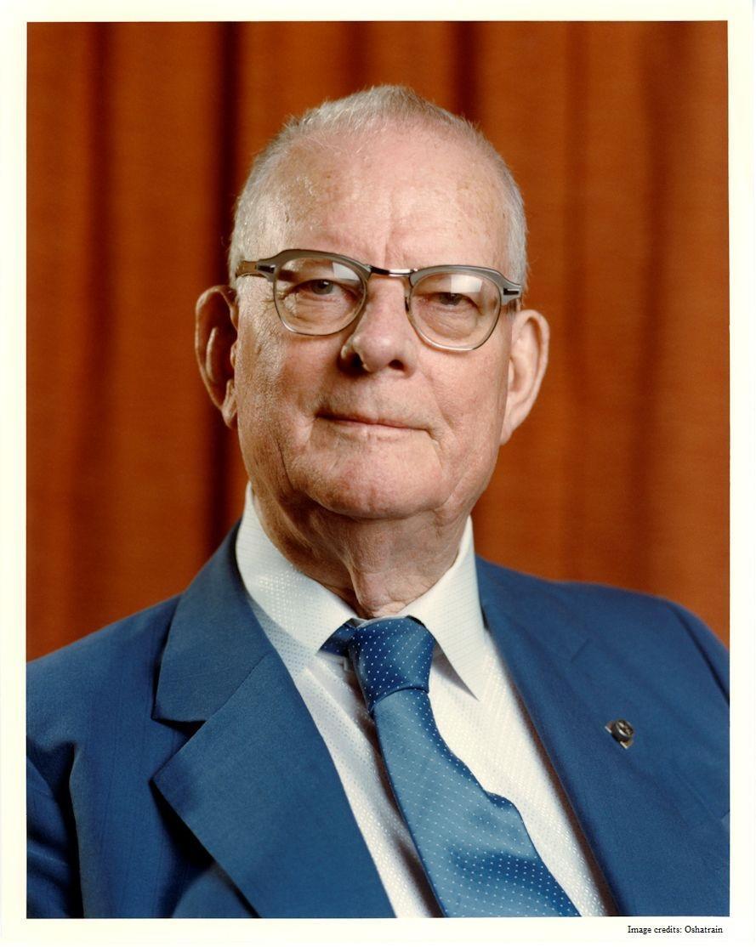
Architect your Value Stream
“
Every system is perfectly designed to get the results it gets.
- W. Edwards Deming

Slide 8
Value Stream Architecture Principles
Architect for Flow and Speed of Delivery (APIs/Microservices, Feature Toggles, Dark Launching)
Replace request/response/SLAs with Self-Service
Implement Flow Metrics
Utilize metrics in retrospectives and ask “what’s slowing us down, how can we go faster?”
Create continuous improvement initiatives which are prioritized with other work and made visible

Slide 9
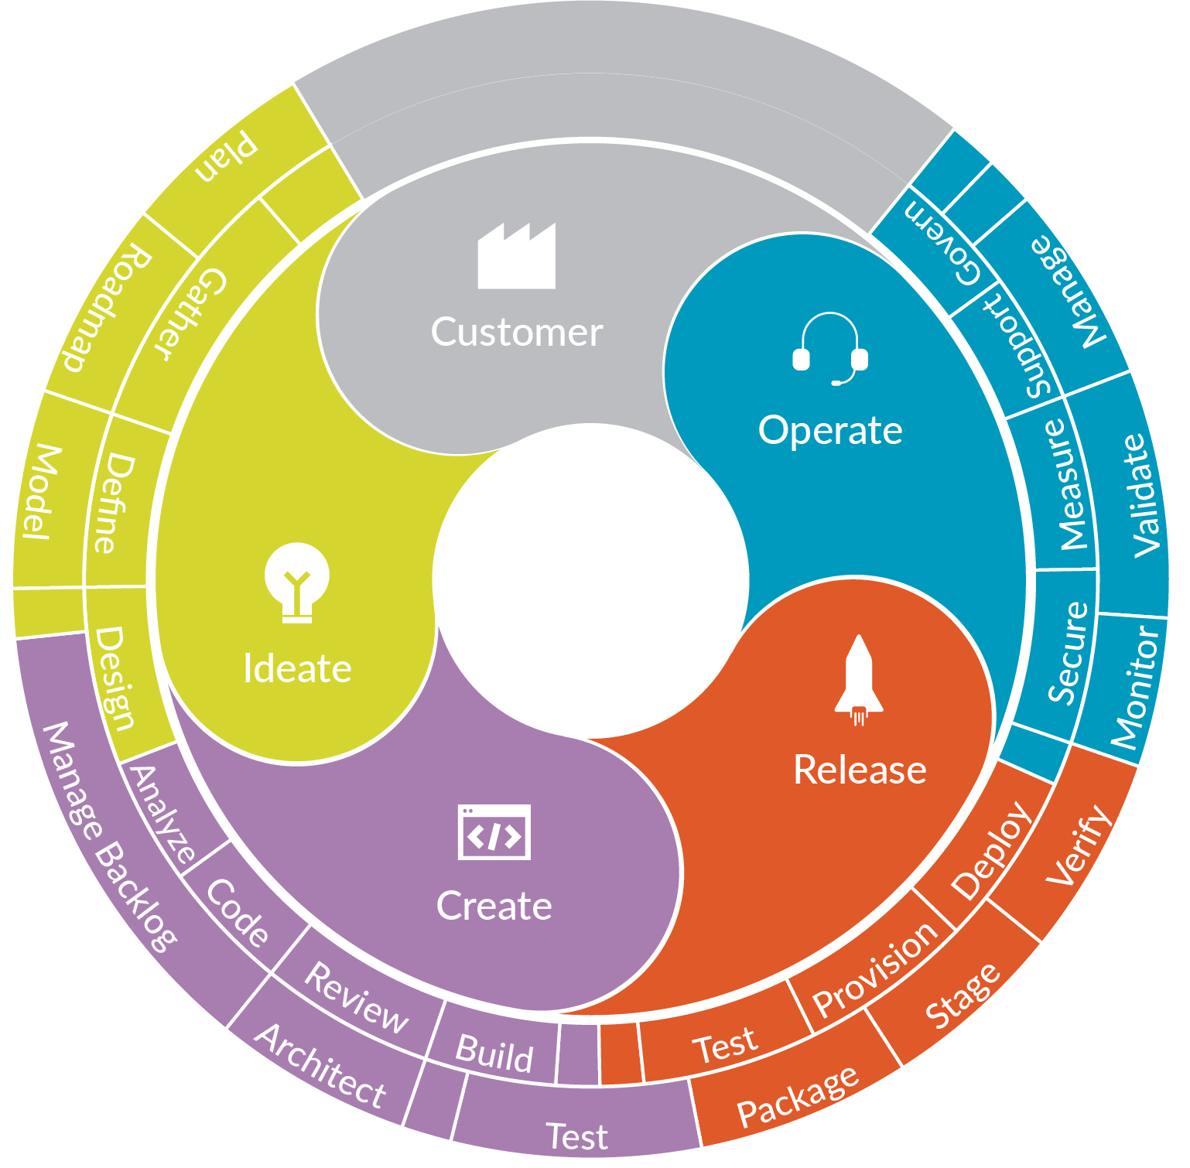
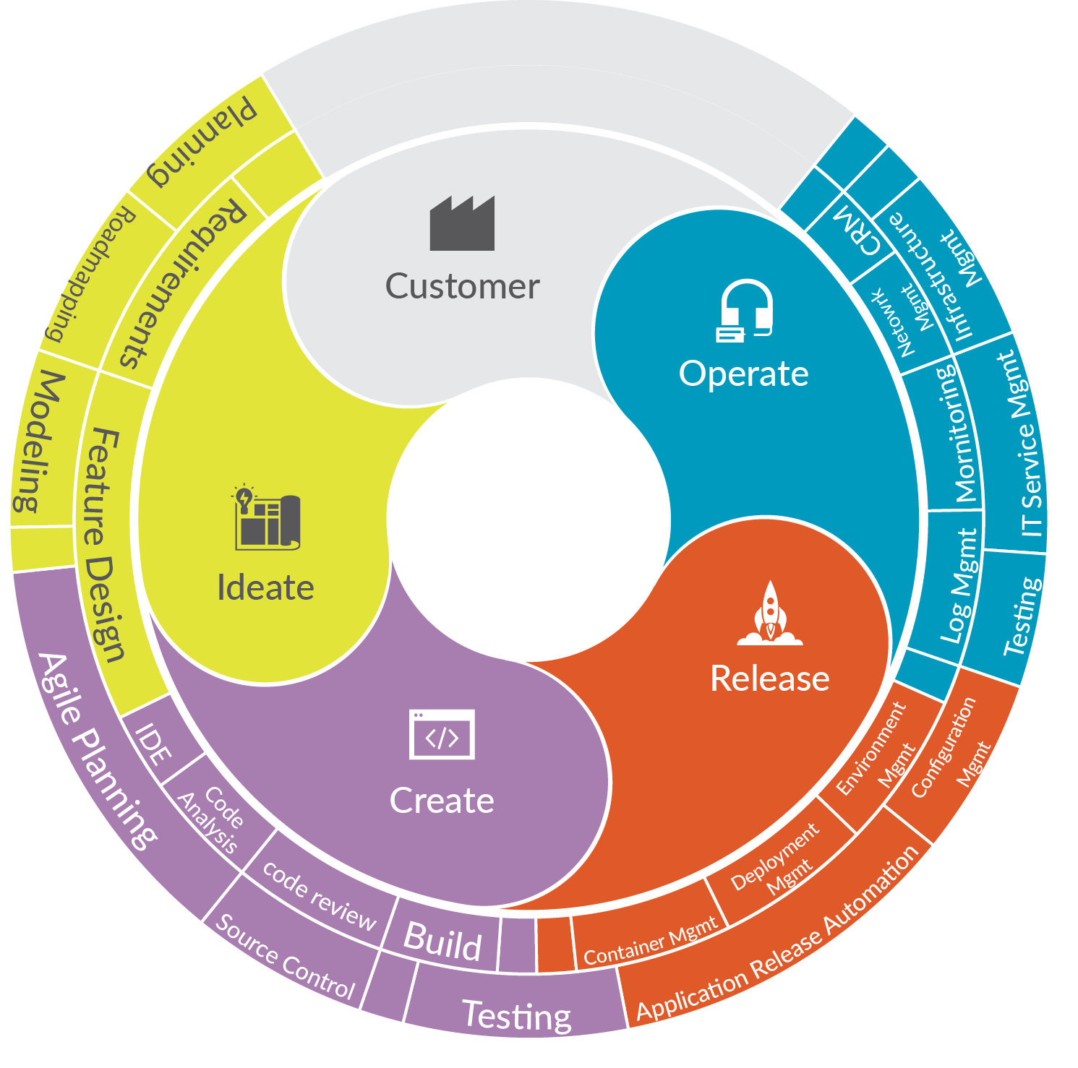
























Notes:
Y’all know how complex it is to build software ….
Sure … at a high level you idea, creat, release, and operate…
ALWAYS ABOUT THE CUSTOMER
But that really translates to a large number of activites
And all of those activities are accomplished with a variety of tools performed by a variety of roles
….
So your success at building software had direct dependencies on your tool landscape … and how well the tool landscape operates…

Slide 10
Architect an Integrated Delivery Pipeline Product
Utilize Best of Breed Tools (vs Best of Suite)
Connect them using standard integration patterns/technologies
Utilize model based integration so the workflow model isn’t disrupted when a different tool is implemented
Model and Measure your workflows
Idea -> Feature -> Story -> Dev -> Commit -> Build -> Deploy
Incident -> Defect -> Dev -> Commit -> Build -> Deploy
Risk Story (or Debt) -> Dev -> Commit -> Build -> Deploy

Slide 11

Optimize the System to Increase Flow
Gene Kim
“Optimize the performance of the entire system rather than a specific silo of work
W. Edwards Deming
“ Balance practitioner feedback with taking a systems approach

Slide 12
Product Value Stream Flow Items
Flow Item | Delivers | Pulled by | Description | Example Artifacts
Feature | New business value | Customers | New value added to drive a business result; visible to the customer | Epic, User Story, Requirement
Defect | Quality | Customers | Fixes for quality problems that affect the customer experience | Bug, Problem, Incident, Change
Risk | Security, Governance, Compliance | Security and Risk Officers | Work to address security, privacy and compliance exposures | Vulnerability, Regulatory Requirement
Debt | Removal of impediments to future delivery | Architects | Improvement of the software architecture and operational architecture | API addition, refactoring, infrastructure automation
Project to Product (Mik Kersten) https://itrevolution.com/book/project-to-product/
Notes:
*At Tasktop we have defined in general terms a set of flow items that we can measure. Flow Items are designed for tracking the most generic characterization of work in a way that is most meaningful to business stakeholders and customers. A Flow Item is a unit of business value pulled by a stakeholder in the software delivery process and they are explicitly tied to new business value.
A feature is tied to business value like the delivery of a new epic, user story or requirement.
A Defect is a fix or change that improves the quality of the customer experience which is a value add.
We have identified two other kinds of work. First, there is work on risks. This includes the various kinds of security, regulatory and compliance that must be scheduled onto development backlogs, implemented, tested, deployed and maintained. In other words, this is work that ultimately competes for priority against Features and Defects. The final and fourth type of work is Technical Debt, it describes the need to perform work on the code base that, if not done, will result in the reduced ability to modify or maintain that code in the future. We will discuss calibrating Flow Distribution a bit later, but for example, a focus primarily on Feature delivery can result in a large accumulation of Tech Debt. If work remains undone to reduce the Tech Debt, then it could impede the future ability to deliver Features by making the software architecture too tangled to innovate on.
So it is these flow items that provide us with the abstraction that we need to see business value flow in software delivery.

Slide 13





Core Flow Metrics
How much value are customers getting per quarter?
Do we spend more time waiting on work than actually doing work?
How long from request to release does it take for my teams to release a feature?
Flow Velocity
Flow Efficiency
Flow Time
Are my teams thrashing because of too much WIP?
Am I allocating the right capacity towards features vs. risks vs. defects vs. debt?
Flow Load
Flow Distribution

Slide 14
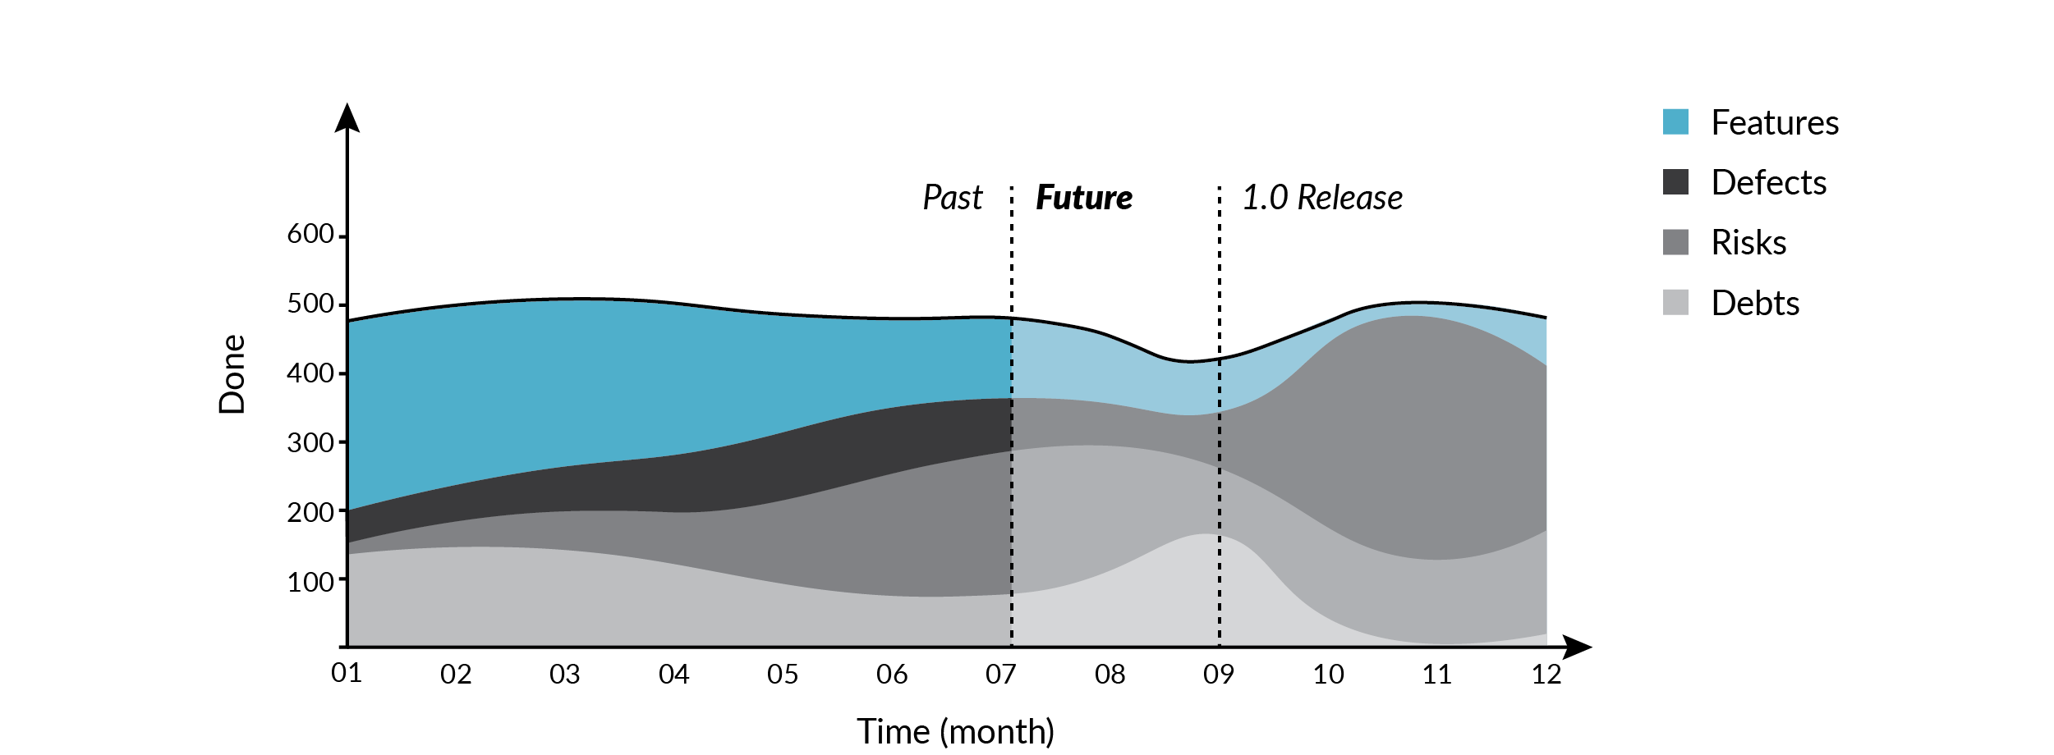
Flow Distribution

Slide 15
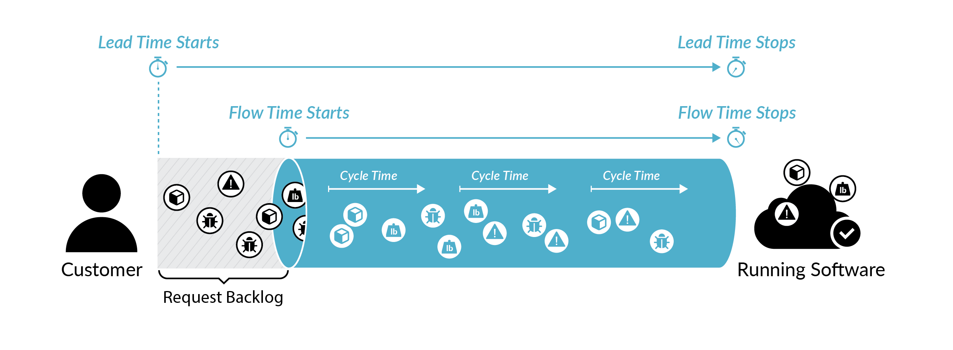
Flow Time

Slide 16
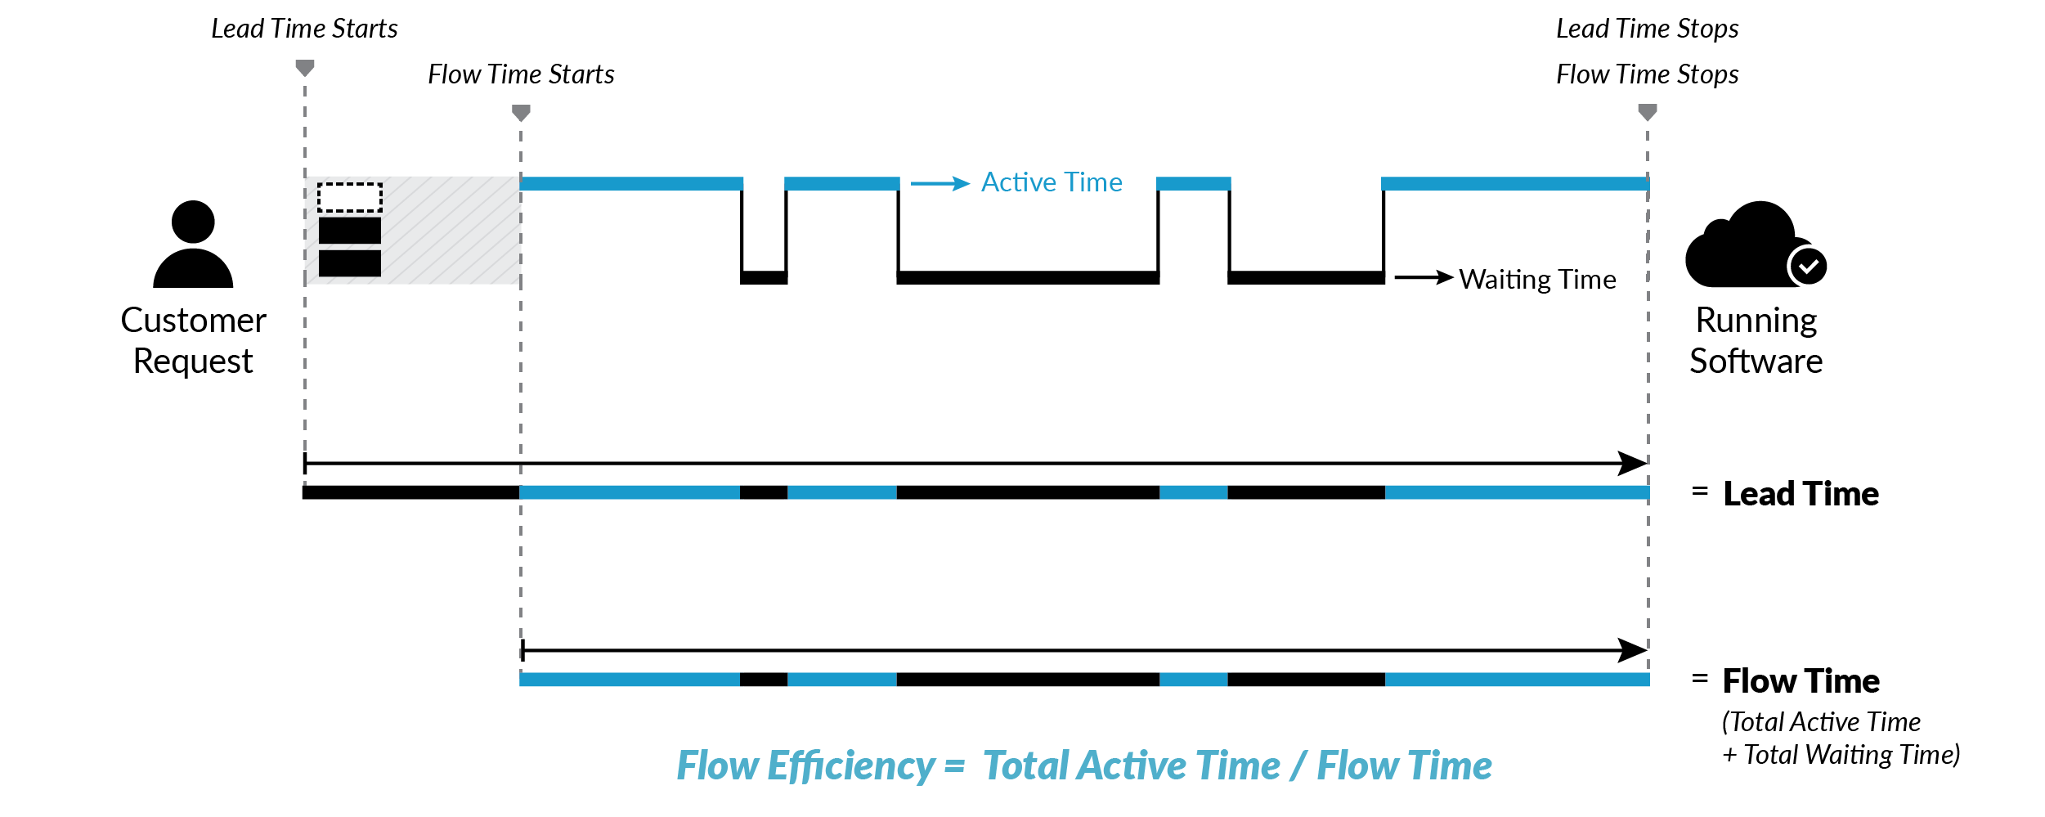
Flow Efficiency

Slide 17
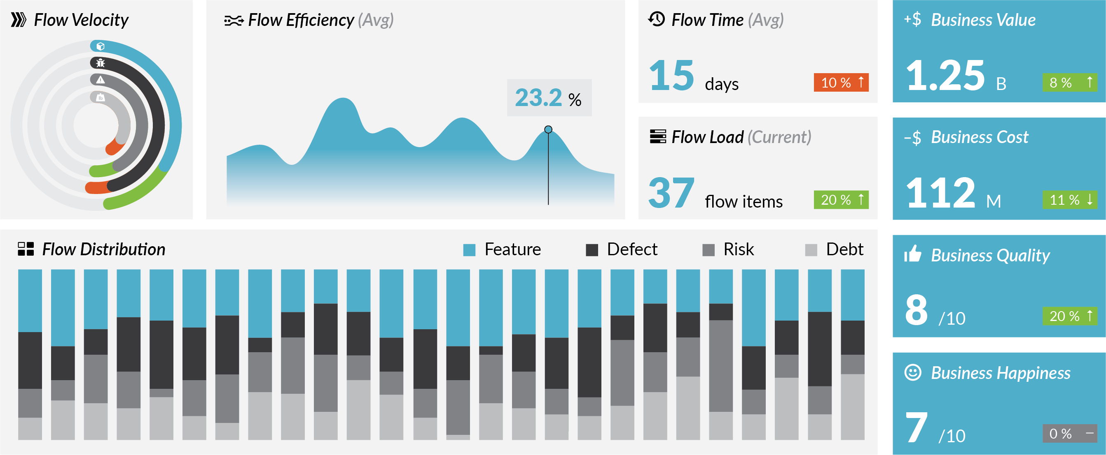
Example Flow Dashboard

Slide 18
Culture
“
Culture eats Strategy for Breakfast.
– Peter Drucker

Slide 19
Silos Disrupt Flow
Left on their own, the vertical silos will naturally create disruption in the flow of value. Organizational and functional affinity negatively disrupts horizontal flow.

Slide 20
Move From Project to Product Teams
Prioritization
Cross-skilling
Funding
InnerSourcing
Empower

Slide 21
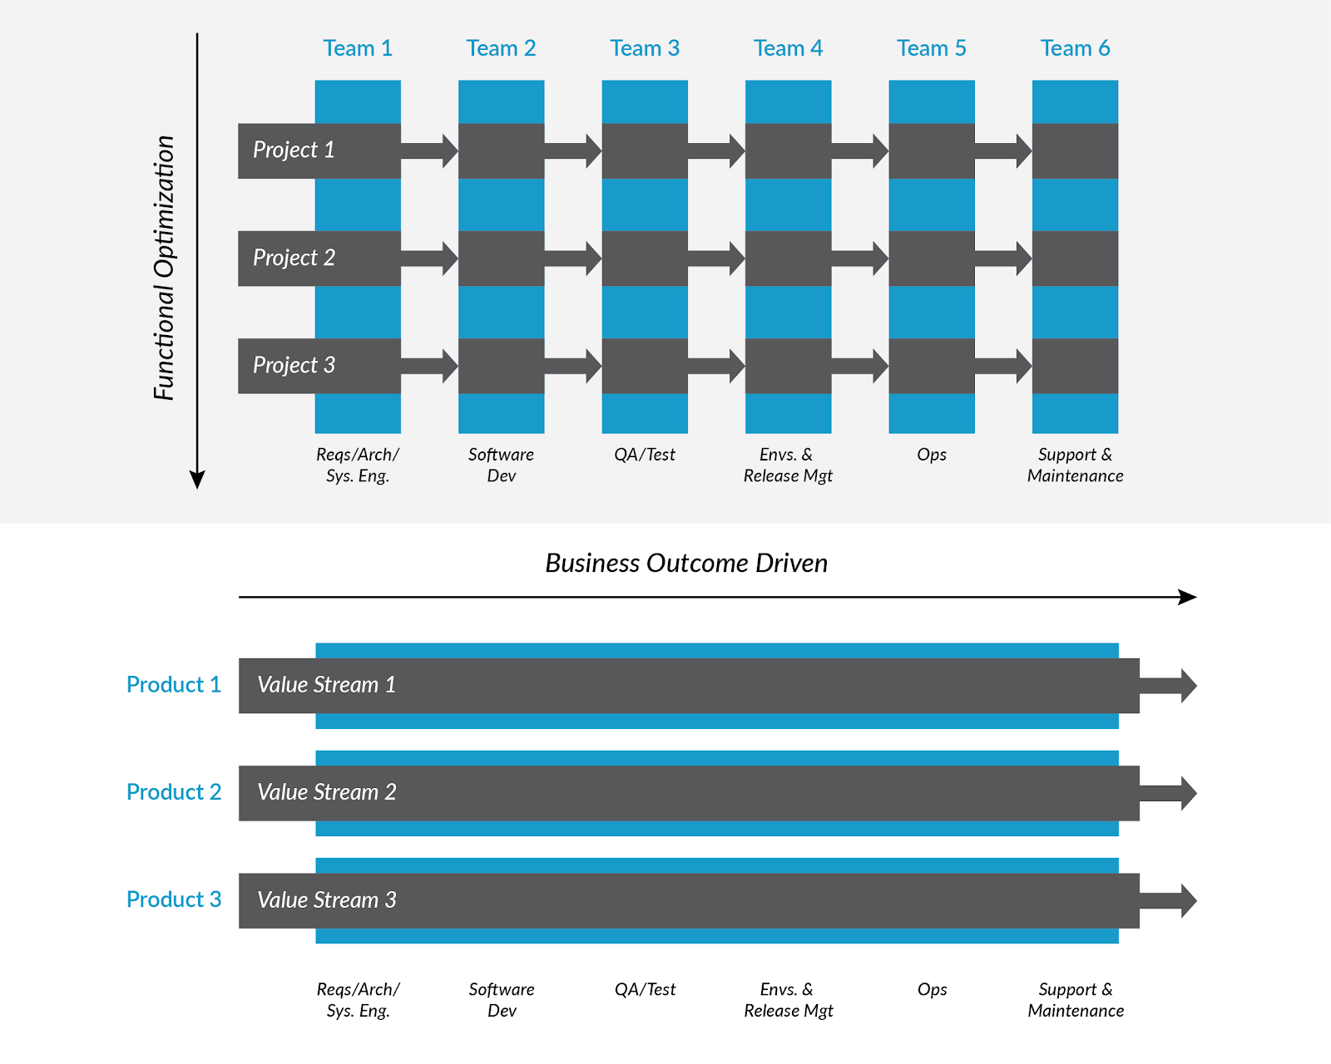
Move from Functional Optimization

Slide 22
To Business Value Optimization

Slide 23

Get Started on your Journey
Continuously Improve
Scale
Show and Tell
with Executives
Make the adoption
work visible
Experiment
07
Empower the
Product Team
Celebrate
SUCCESS
Start Small
https://itrevolution.com/forum-papers/
Notes:
Start Small
Experiment
Develop success criteria (e.g. increased flow) and flow metrics
Make the adoption work visible
Moving to this model requires work that needs to be accounted for
Show and Tell with Executives
Celebrate Success - Tell and Share Stories!
Patience to Persevere

Slide 24
Resources
From Project to Product (Mik Kersten)
https://itrevolution.com/book/project-to-product/
Standing On Shoulders: A Leaders Guide to Digital Transformation (Jack Maher, Carmen DeArdo)
https://standingonshoulders.us/
DevOps Handbook (Gene Kim, John Willis, Patrick Dubois)
https://itrevolution.com/book/the-devops-handbook/
(Beyond) The Phoenix Project (Gene Kim, Kevin Behr, Kim Spafford)
https://itrevolution.com/book/beyond-phoenix-project/
Making Work Visible (Dominica DeGrandis)
https://itrevolution.com/book/making-work-visible/
Accelerate (Nicole Forsgren, Gene Kim, Jez Humble)
https://itrevolution.com/book/accelerate/

